Slide 1


Free Google Services for your Council and Assembly

Slide 2
Disclaimer
This information is being provided for informational purposes only and does not constitute or imply an endorsement of the service or product by the Knights of Columbus, including the Louisiana State Council.
The Knights of Columbus bears no responsibility for damage or loss arising from using this product or service.
Any potential users of these products or services should conduct their own due diligence and assessment of the product, or services as appropriate for their needs.

Slide 3
A Few Services

Slide 4
Google has many free services to help your Council or Assembly stay on top of things in the digital age today. Here are just a few

Slide 5

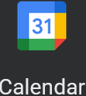

Google has many free services to help your Council or Assembly stay on top of things in the digital age today. Here are just a few
Free email address for the council or assembly to use to sign up for other services and to communicate council or assembly business as the entity itself. The access can be transferred over when officers change since it is not setup as an individual's email address.

Slide 6
Google has many free services to help your Council or Assembly stay on top of things in the digital age today. Here are just a few
Free calendar that can be published on a website and shared with your members on whatever form of online or cell phone calendar they are currently using. Keep everyone up to date on when your next meeting or fundraiser is with Google Calendar.

Slide 7
Google has many free services to help your Council or Assembly stay on top of things in the digital age today. Here are just a few
Free online storage up to 15GB. Store important documents securely in the cloud with Google drive.

Slide 8
Getting Started

Slide 9
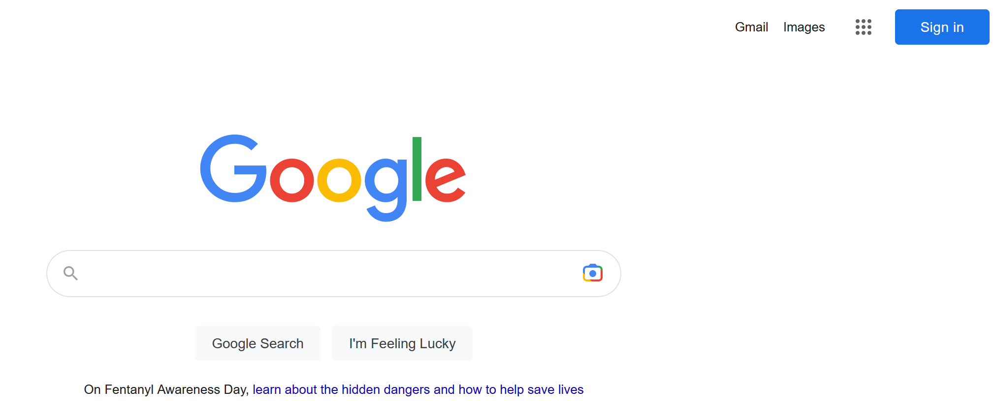
Go to the Google website and sign up for a free account
Click the Sign in button

Slide 10
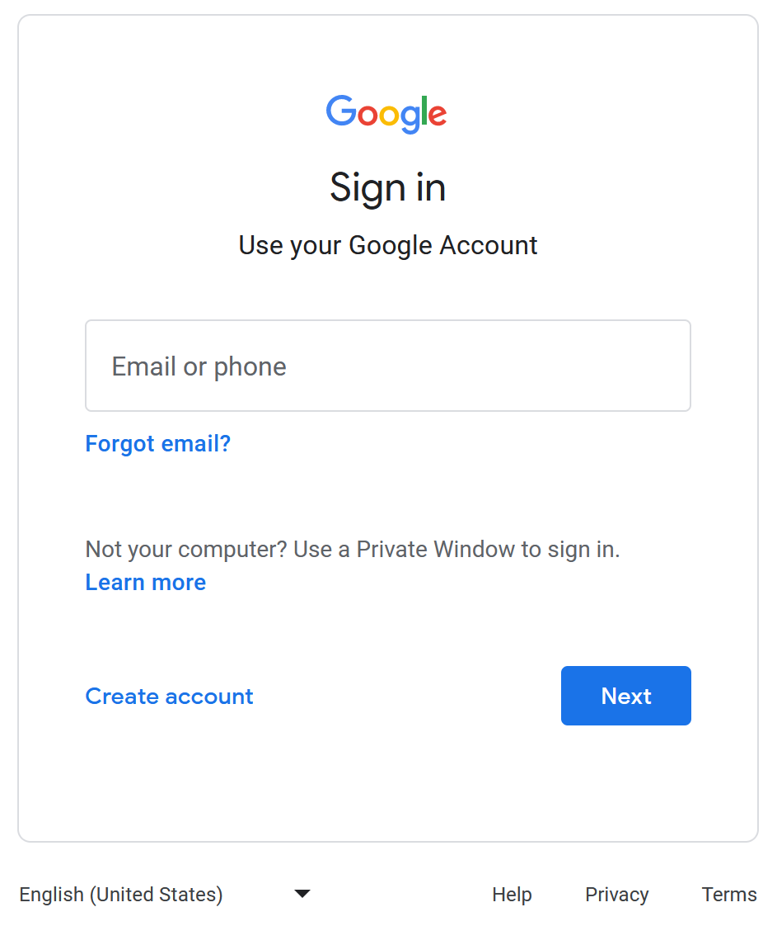
Go to the Google website and sign up for a free account
Select the create account link

Slide 11
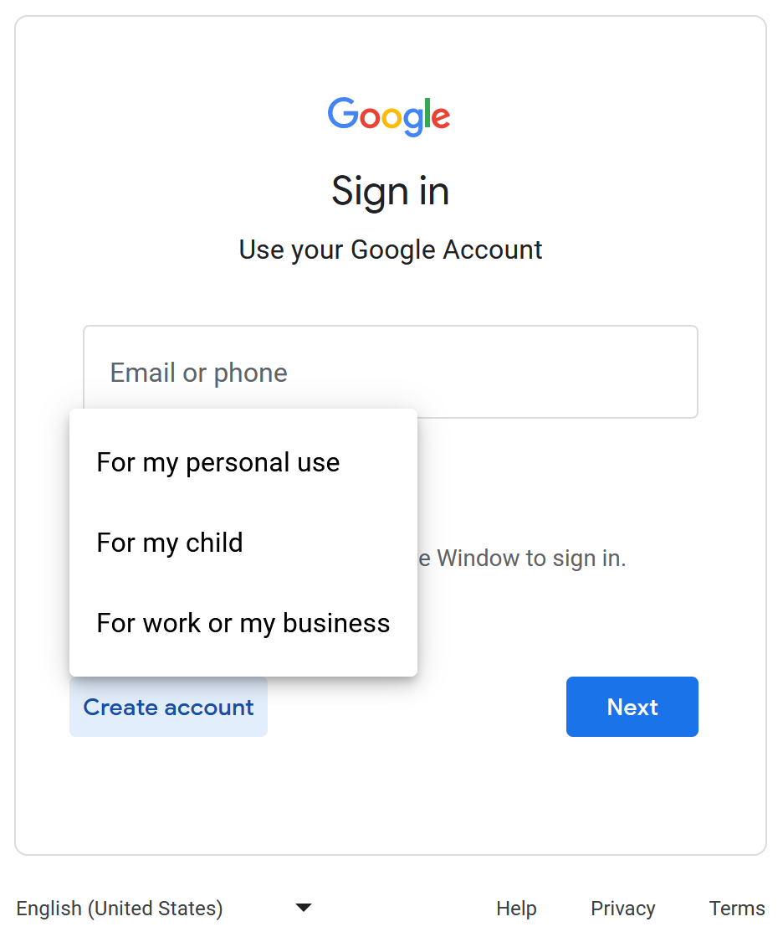

Go to the Google website and sign up for a free account
Select For my personal use

Slide 12
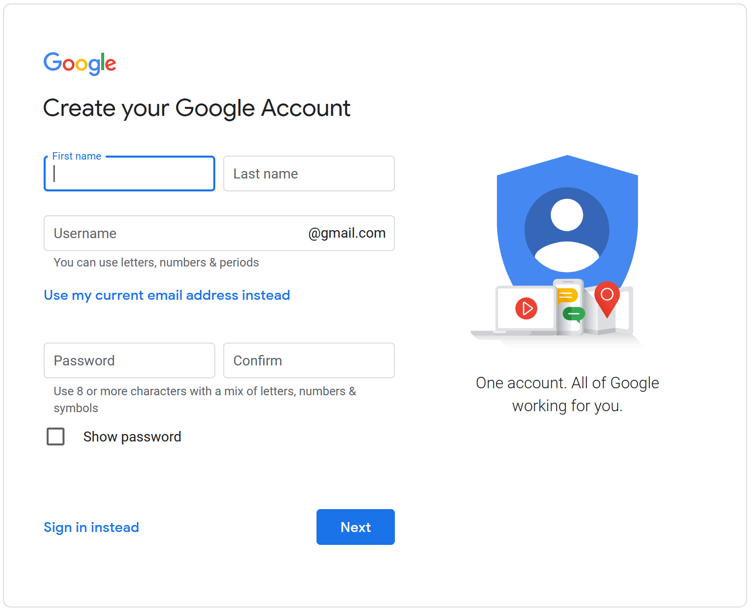
Go to the Google website and sign up for a free account
Use your Council or Assembly name and setup a username that is easy to remember and is relevant.
(Ex. KC9247 or KCA2241)
Create a password that is secure and easy to remember.
Click the Next button when this is done.

Slide 13
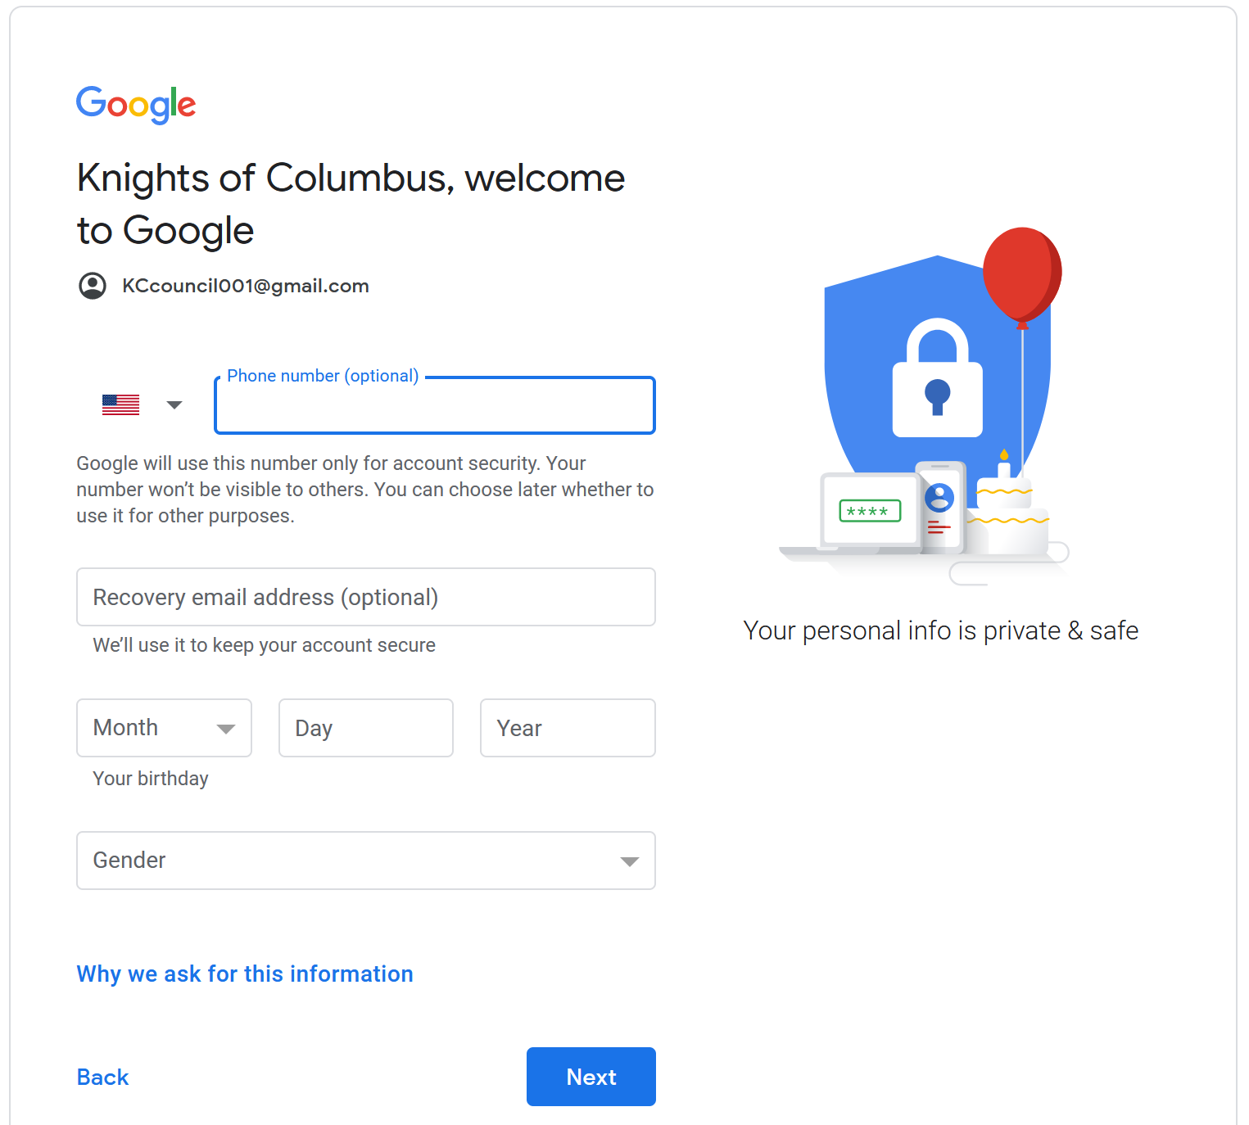
Go to the Google website and sign up for a free account
Enter your cell phone number for verification purposes. (this can be changed later)
Google will not unlock all features unless it believes you are 18 or older. Enter the birthday to reflect as such.(if your Council or Assembly is 18 years or older use the date it was formed)
Fill out the Gender section and press the Next button.

Slide 14
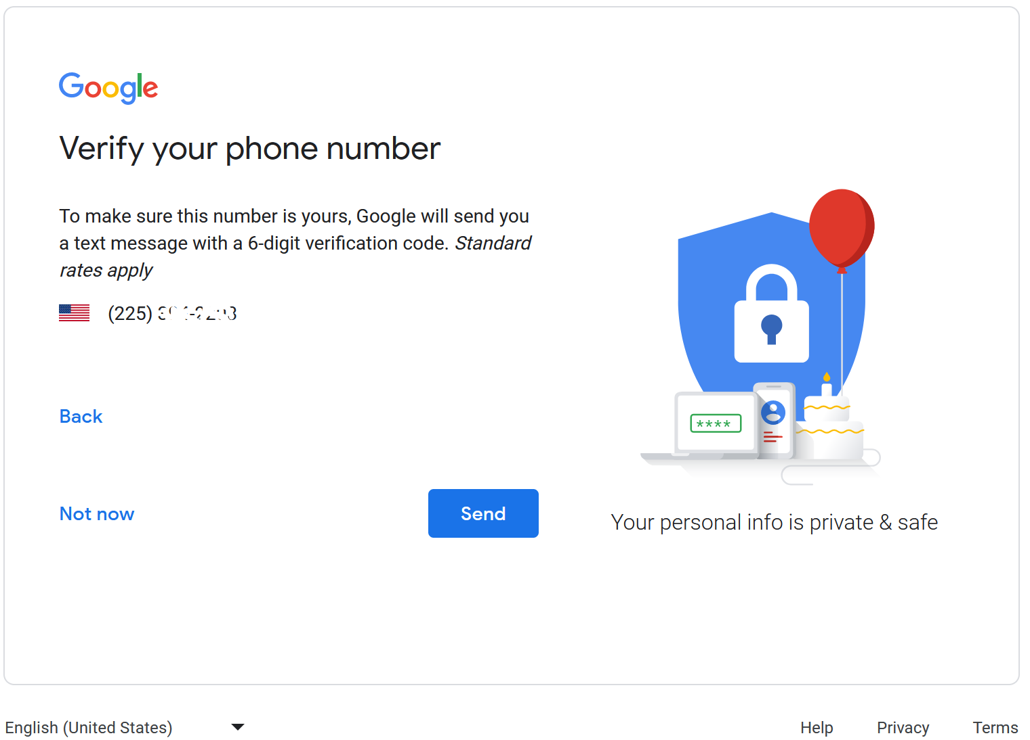
Go to the Google website and sign up for a free account
Click the Send button to verify the new account
You will receive a text message to the phone number you provided, and it will contain a G code.
Enter the G code on the next page and press the Verify button
Press the Skip button when asked if you would like to use your phone number with other Google services.

Slide 15


Go to the Google website and sign up for a free account
Finally agree with the terms and conditions and get started using your Free Google Services!

Slide 16

Questions, Please Contact me
Brett Cormier
Technology Director Louisiana State Council
tech@louisianakc.org

